Slide 1


Slide 2

Room Rental System
TO
Department of Computer Science
PROJECT WORK _ 6sem
Supervisor
Submitted By
Your Name
Roll No.

Slide 3
Contents
Introduction
Objective
Requirements specifications
Modules
Features
Languages
ER Diagram
DATA FLOW DIAGRAM
Context Level Data Flow Diagram
WORK CHART
USER INTERFACE DESIGH
CONCLUSION
Future scope of the project

Slide 4
Introduction
An Online Room Rental System will provide the Information about Rooms/Flats/Houses which is available for Rent.
Room Rental system will make easy to find the location of Rooms/Flats/Houses, select no. of rooms and other facts by the renter.
It will make easy to upload the location, contact No., expected rent, No. of rooms, Facilities and information by landlord/room-master.
With [Online Room Rental System], we can set up room online and the customers can easily book room with a simple mouse click. Also with a book room online we can easily track the facility, maintain customer's database and improve the room facility service. We can receive order through directly view on website.

Slide 5
Objective
To save manpower.
It will speed the processing of data.
It will provide best security features such as provisions of passwords.
To develop a user friendly system that requires minimal user training.

Slide 6
REQUIREMENTS SEPECIFICATIONS
HARDWARE AND SOFTWARE SPECIFICATION
Hardware Requirements
Pentium IV Processor
512 MB RAM
40 GB HDD
Colour Monitor
Keyboard, Mouse
Software Requirements
Python 3 (Any version)
Any text editor (PyCharm, Notepad++ etc.)

Slide 7
MODULES
The system after careful analysis has been identified to be presented with the following modules
Online Renting System deals with the following modules

Slide 8
Registration (User) : The User fills the registration form by giving the personal information and successfully registers with the website.
2. Admin: After entering into admin home page will add new room by filling add room form, by providing sufficient details about room such as room number, available dates, rent etc and upload the image of that room or house .It consists of following sub modules:1.
Update room: Admin can update the existing room details such as rent, available dates, etc.
Delete room: admin can also delete the room.
3.Data base maintenance: The data provided by the admin such as room details, personal details, etc. and data provided by the customer such as feedback and booking details will be maintained in a data base.
4.Searching and Booking the room: The Customer after accessing the site searches for room, if he/she finds the required room then he/she need to fill the signup form and submit to the database.
5.Authentication: Authentication is nothing but providing security to the system . Here everyone must enter into the system through login page.

Slide 9
USER MODULES
An user has to login to the site using his unique user id and password.
User can view Room which is Add by admin.
User can a view status of book room.
User can view the about us page of website.
User can view the contact us page of website.

Slide 10
Admin module
An Admin has to login to the site using his unique user id and password.
Admin can manage room (add/update/delete).
Admin can view list of user and booking.
Admin can view the feedback and contact list.
Admin can also change the password .

Slide 11
Features for user
Signup
Login
Update profile
Give feedback
Change password

Slide 12
Features for Admin
Login
View/update room
Add/delete room
View booking
View feedback
View contact
Change password
logout

Slide 13
Languages
Front end: HTML, CSS, JavaScript
Back end: Python, SQLite
HTML: HTML is used to create and save web document. E.g. Notepad/Notepad++
CSS : (Cascading Style Sheets) Create attractive Layout
Bootstrap : responsive design mobile friendly site.
JavaScript: it is a programming language, commonly use with web browsers.
Python: Python is an interpreted, object-oriented, high-level programming language with dynamic semantics.
SQLite(database): SQLite is a database, widely used for accessing querying, updating, and managing data in databases.

Slide 14
ER DIAGRAM

Slide 15
DATA FLOW DIAGRAM
The data flow diagram shows the flow of data within any system. It is an important tool for designing phase of software engineering. Larry Constantine first developed it. It represents graphical view of flow of data. It’s also known as BUBBLE CHART. The purpose of DFD is major transformation that will become in system design symbols used in DFD.
In the DFD, four symbols are used and they are as follows.

Slide 16
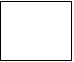

1. A square defines a source (originator) or destination of system data.
2. An arrow identifies data flow-data in motion. It is a pipeline through which information flows.
3. An open rectangle is a data store-data at rest, or a temporary
Repository of data.
4. A circle or a “bubble “(Some people use an oval bubble) represents a process that transfers informing data flows into outgoing data flows.

Slide 17
Context Level Data Flow Diagram
This level shows the overall context of the system and its operating environment and shows the whole system as just one process. Online book store is shown as one process in the context diagram; which is also known as zero level DFD, shown below. The context diagram plays important role in understanding the system and determining the boundaries. The main process can be broken into sub-processes and system can be studied with more detail; this is where 1st level
DFD comes into play.

Slide 18
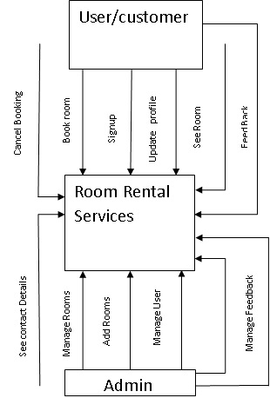
Zero Level Data Flow Diagram
Manage Booking

Slide 19
First Level DFD This level (level 1) shows all processes at the first level of numbering, data stores, external entities and the data flows between them. The purpose of this level is to show the major high-level processes of the system and their interrelation. A process model will have one, and only one, level-1 diagram. A level-1 diagram must be balanced with its parent context level diagram, i.e. there must be the same external entities and the same data flows, these can be broken down to more detail in the level 1.

Slide 20
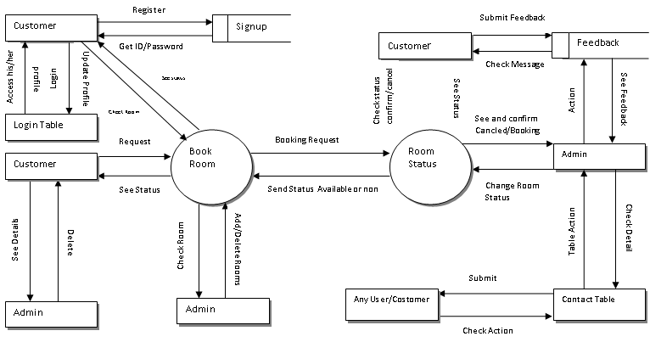
One level data flow diagram

Slide 21
WORK CHART A project plan needs to be created to ensure the timely completion of the project. As part of project analysis, we break the project down to a number of stages and use a Gantt chart to describe specific tasks and status.

Slide 22
ID | Task Name | Duration | Start | Finish | Predecessors |  |  | Resource Names
1 | Project Initiation | 2 days | Sat 6/02/2021 | Mon 08/02/2021
2 | Draft Project Plan | 2 days | Tue 09/02/2021 | Thu 11/02/2021
3 | Analysis Phase | 7 days | Fri 12/02/2021 | Fri 19/02/2021
4 | Plan User Interviews | 2 days | Sat 20/02/2021 | Mon 22/02/2021
5 | Schedule users Interviews | 3 days | Tue 23/02/2021 | Fir 26/06/2021
6 | Conducting users Interviews | 2 days | Mon 1/03/2021 | Wed 04/03/2021
7 | System Design | 20 days | Fri 05/03/2021 | Sat 27/03/2021 | 6
8 | Modules Design | 10 days | Wed 31/8/18 | Sat 10/04/2021
9 | Data Structure Design | 3 days | Mon 12/04/2021 | Thu 15/04/2021 |  | 8
10 | User Interface Design | 3 days | Fri 16/04/2021 | Mon 19/04/2021
11 | Coding Phase | 36 days | Tue 20/04/2021 | Thu 25/05/2021
12 | Testing Phase | 9 days | Wed 26/05/2021 | Fri 04/06/2021
13 | Integration Testing | 5 days | Sat 05/06/2021 | Thu 10/06/2021
14 | System Level Testing | 4 days | Fri 11/06/2021 | Thu 15/06/2021
15 | Implementation | 4 days | Fri 16/06/2021 | Sun 20/06/2021
16 | Post-Implementation Review | 2 days | Mon 21/06/2021 | Wed 23/06/2021

Slide 23
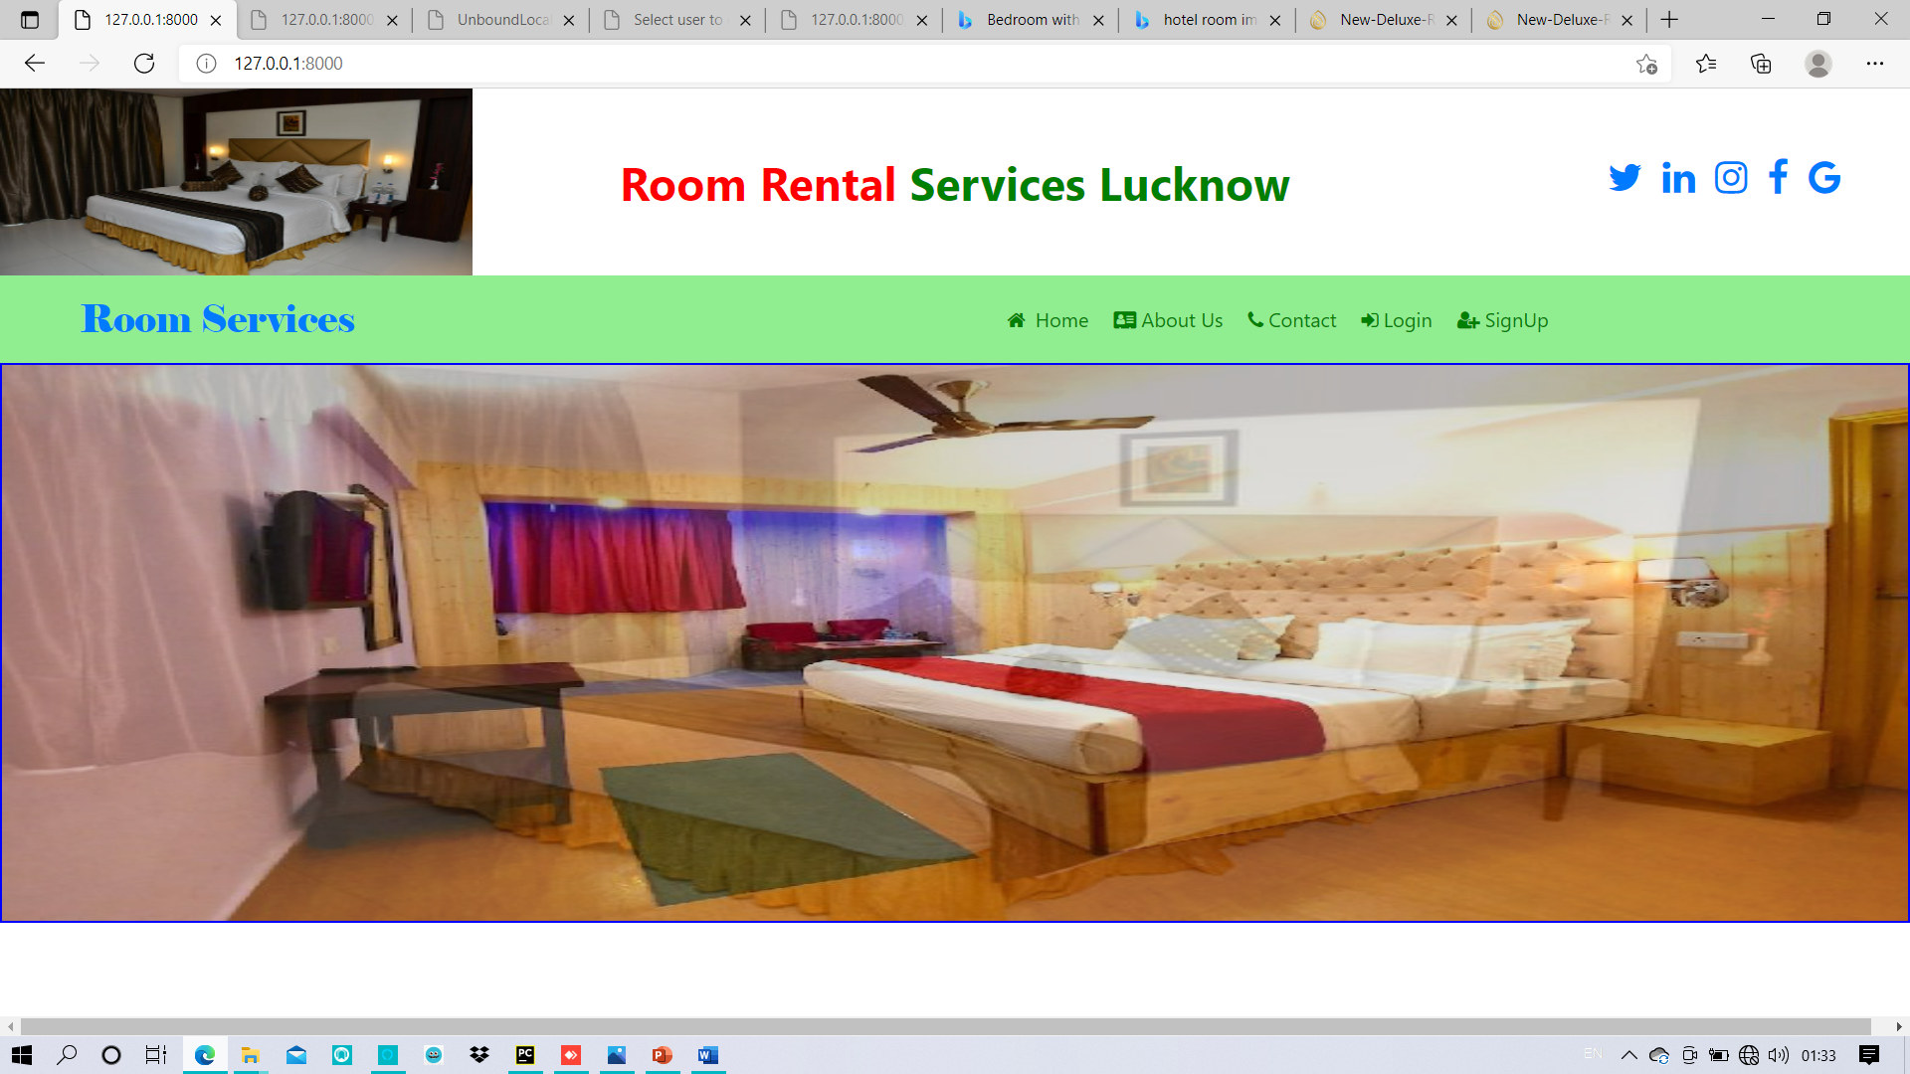
USER INTERFACE DESIGH Screenshot 1: Home Page

Slide 24
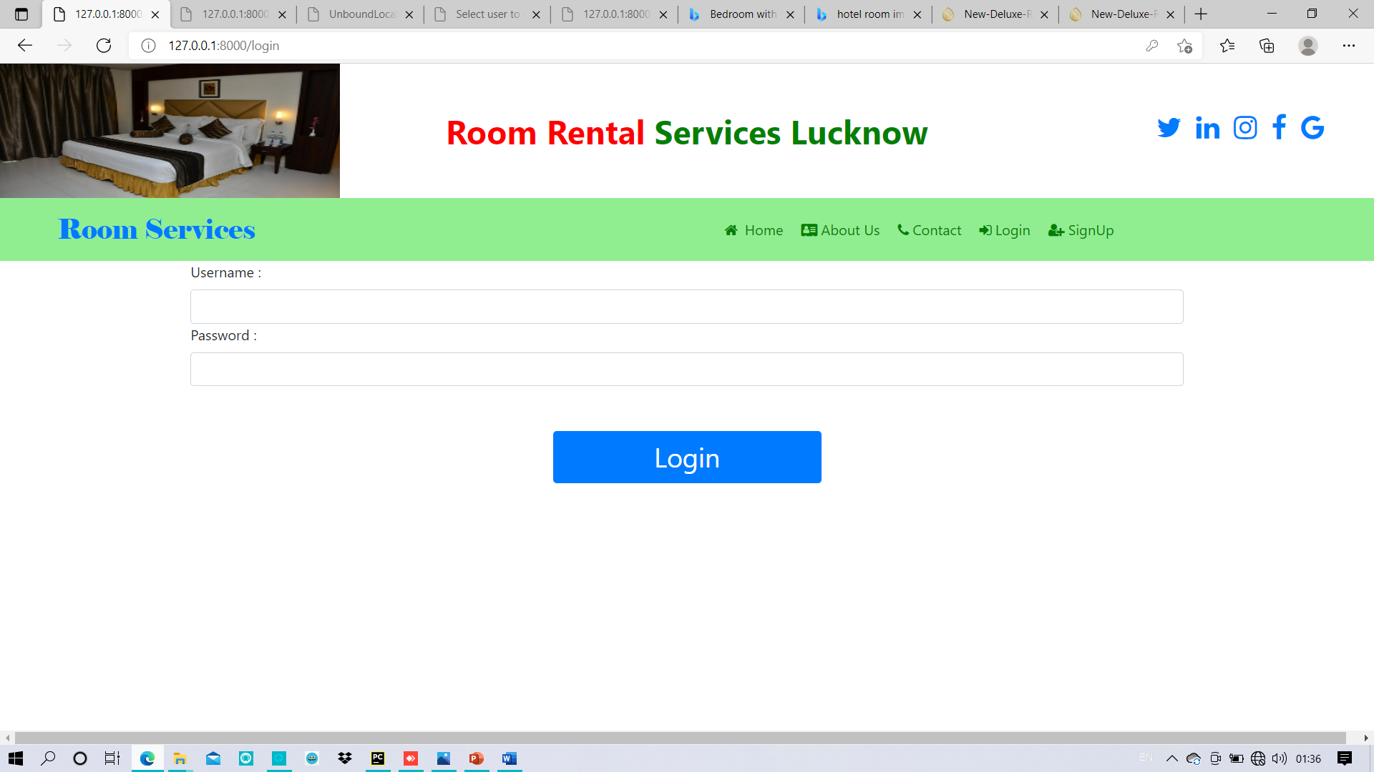
Screenshot 2: Login Page

Slide 25
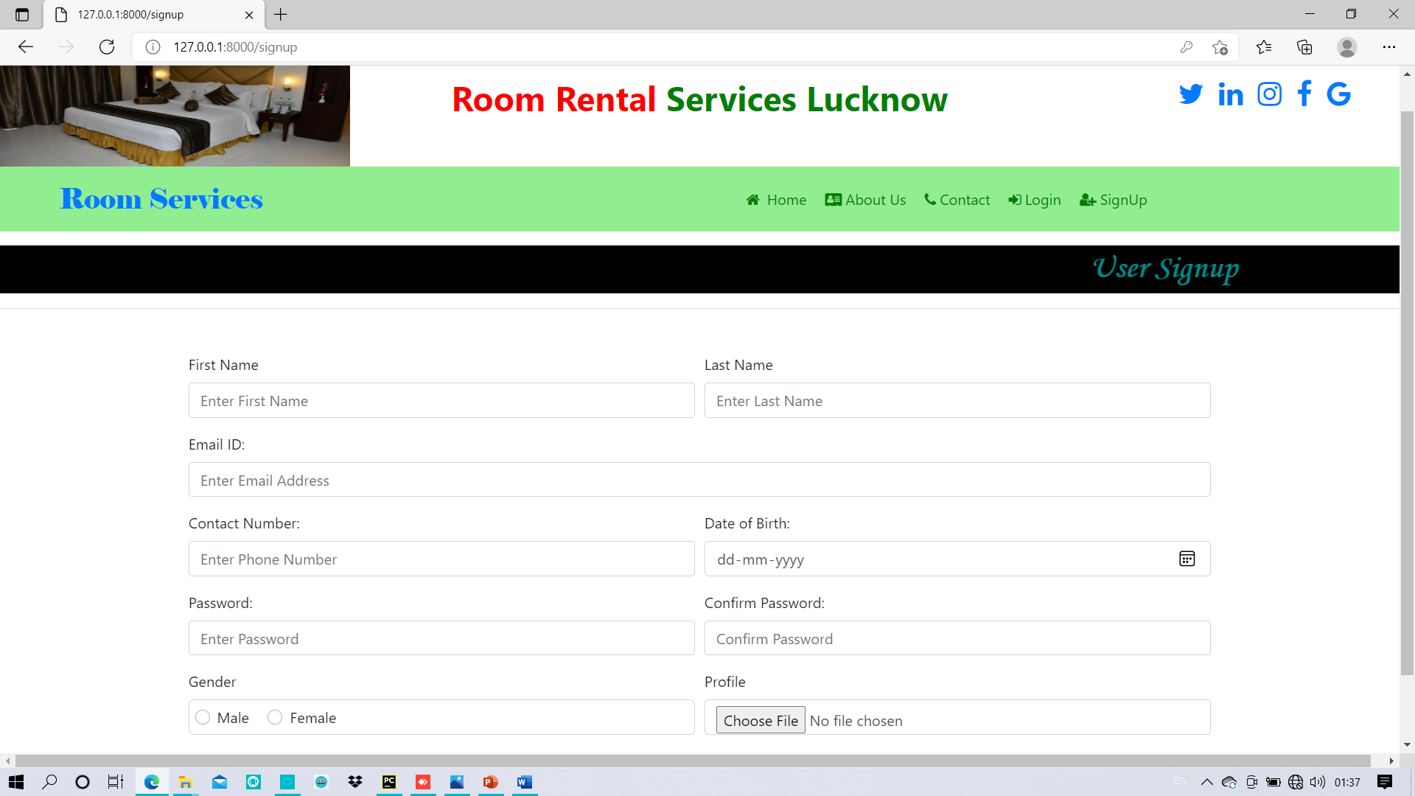
Screenshot 3: Signup Page

Slide 26
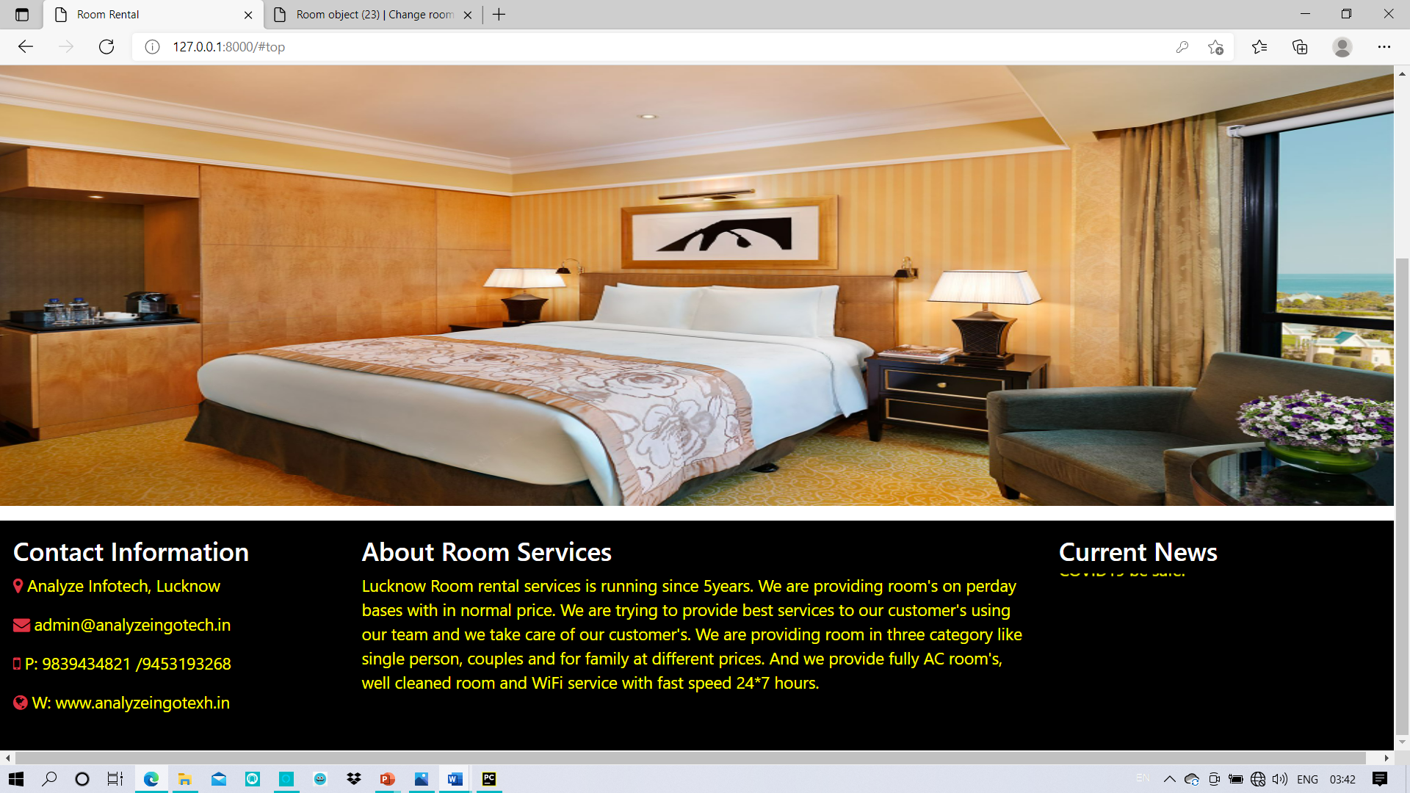
Screenshot 4: about us

Slide 27
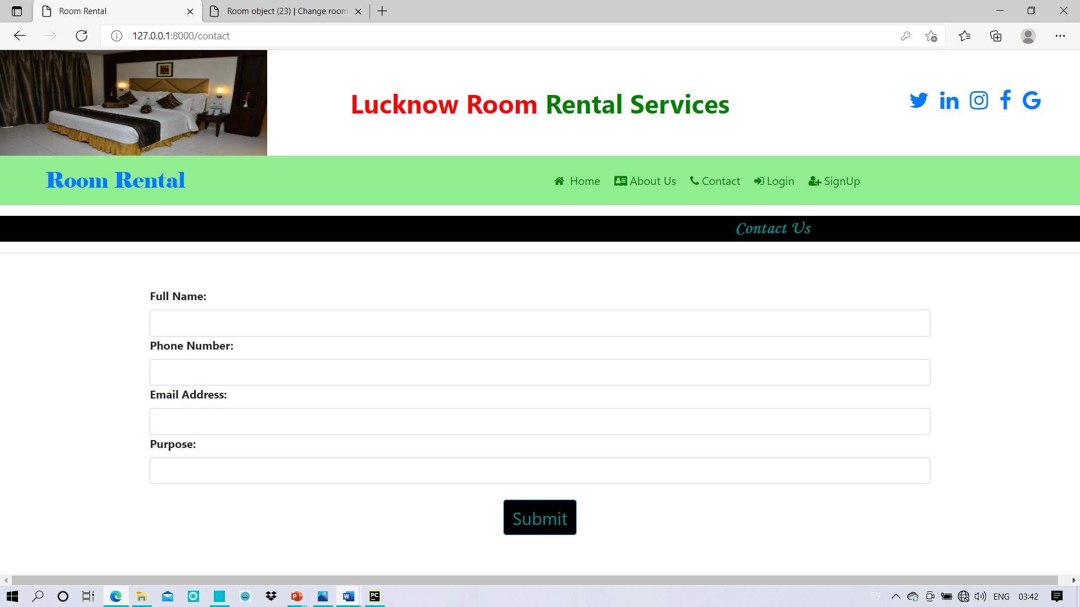
Screenshot 5: contact

Slide 28
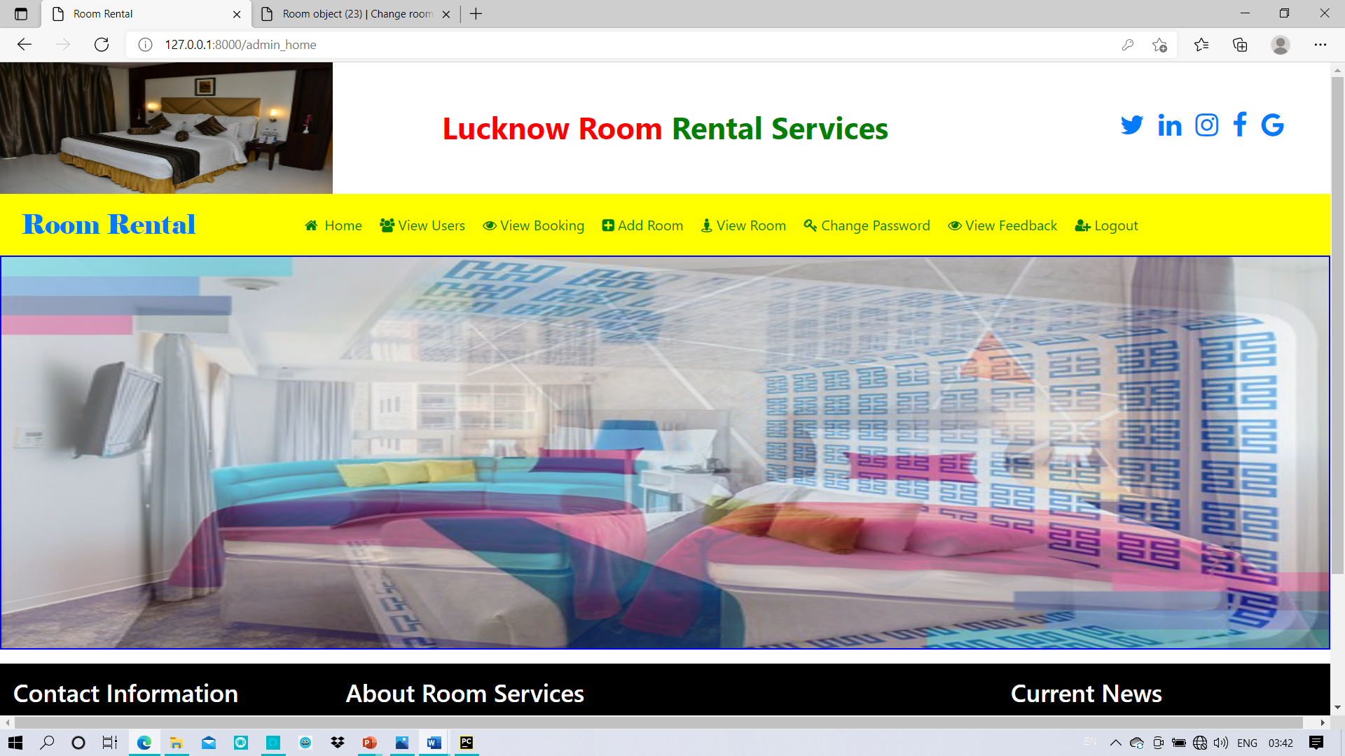
Screenshot 6: Admin home page

Slide 29
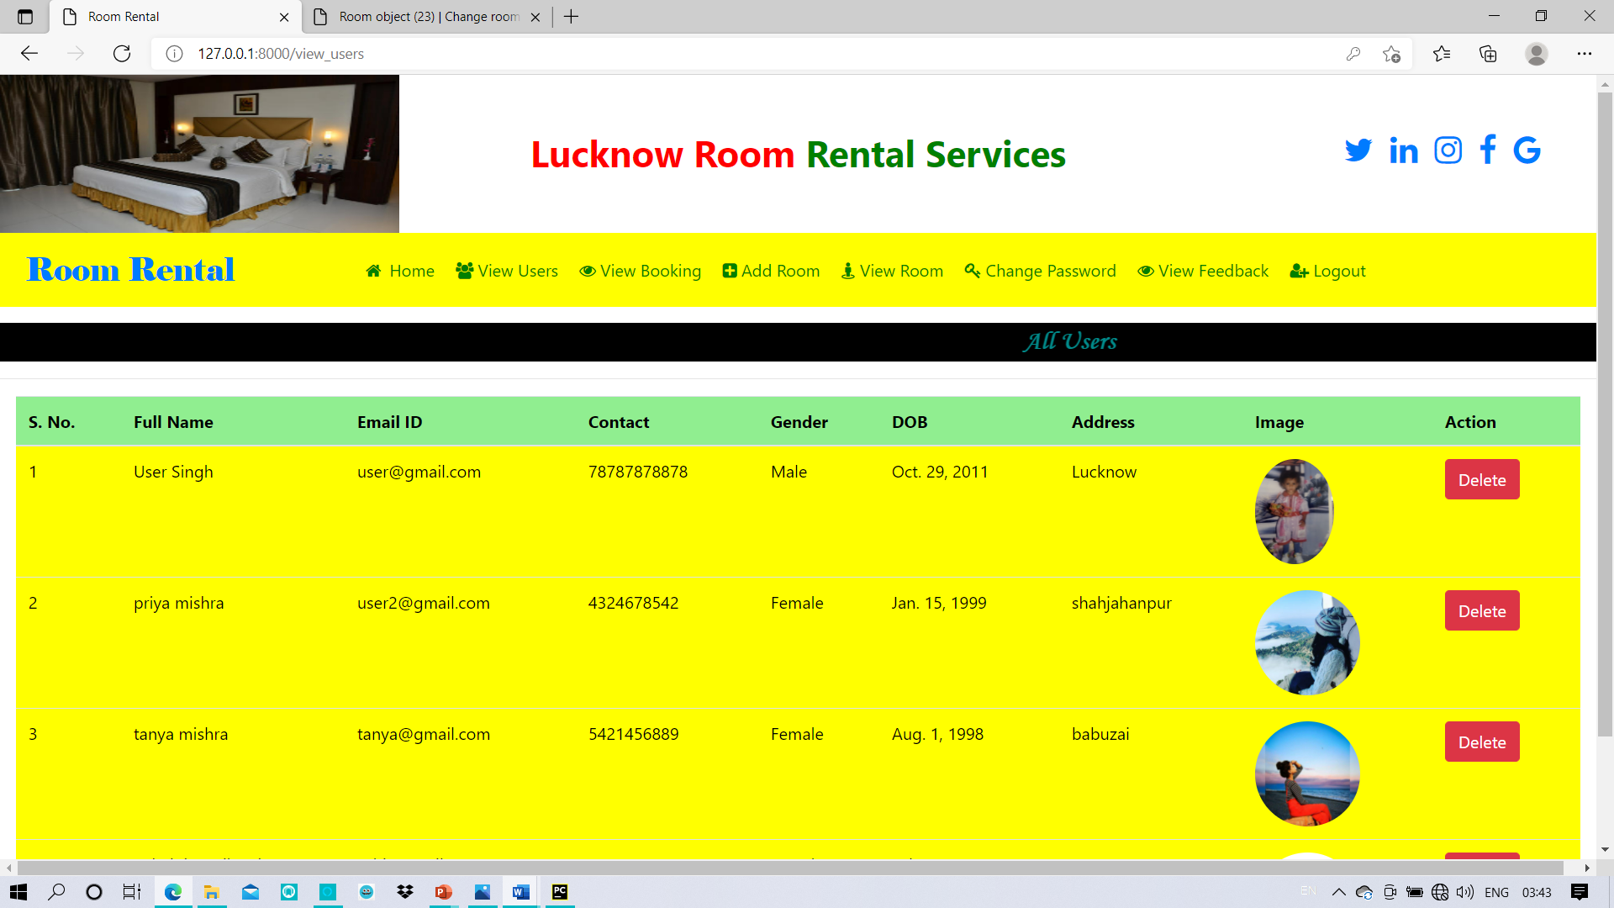
Screenshot 7: view all user

Slide 30
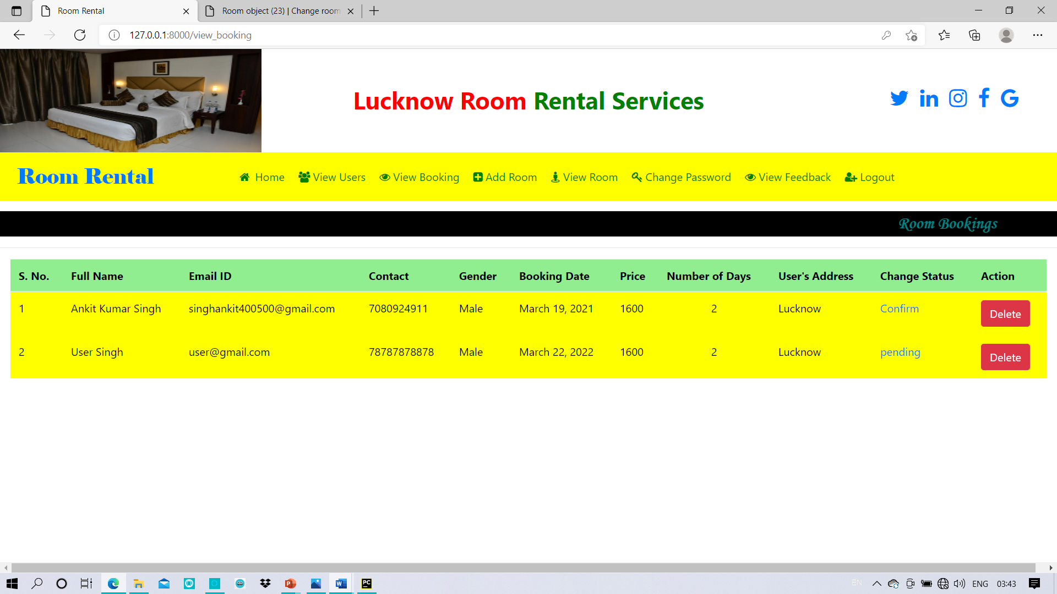
Screenshot 8: Room Booking

Slide 31
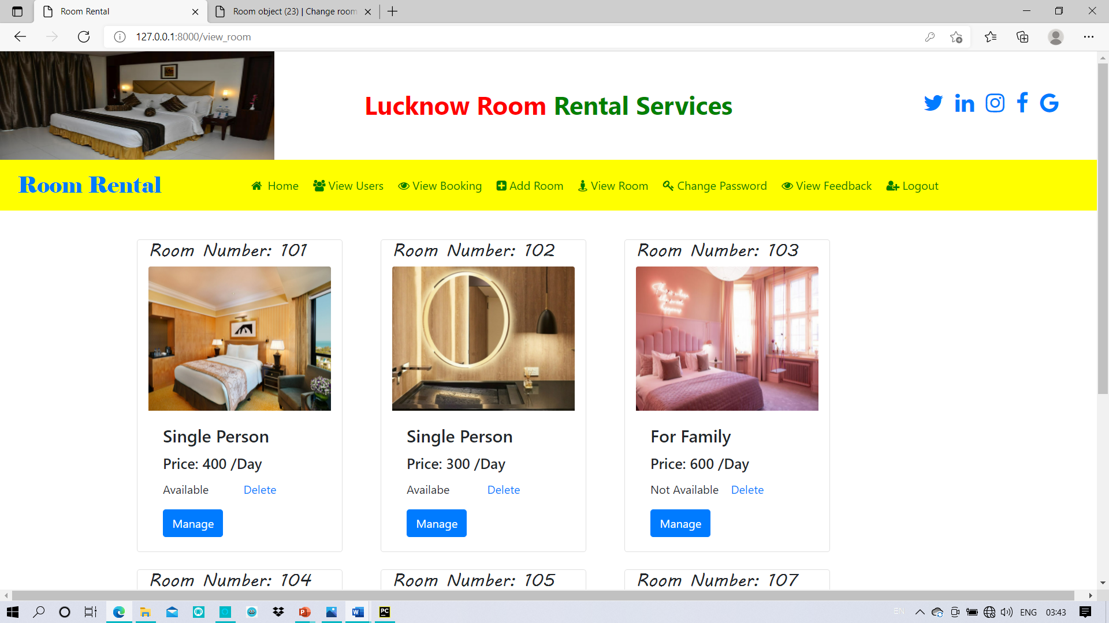
Screenshot 9: add or delete room

Slide 32
CONCLUSION
Effectively resolving the apartment issues is important to the buyer's long-term future, the Room Rental Project will be an important tool for creating rental Room stability by helping tenants .

Slide 33
FUTURE SCOPE OF THE PROJECT
In future our project is meant to satisfy the needs of room rental . Several user friendly interfaces have also been adopted. This package shall prove to be a powerful in satisfying all the requirements of the users. When we can update the system, we can add GPS system in build and can give live chat online option to users. This project can also be extended to IOS Platform and several state Database can be included.

Slide 34
THANK YOU

